Slide 1
Project Matryoshka
Zhehao Wang, XJTU
Mentors :
Prof. Jian An XJTU
Prof. Lixia Zhang, UCLA CSD
Prof. Jeff Burke, UCLA REMAP

Slide 2


Background
Matryoshka
Is a massive multiplayer online game (MMOG)
Running on named data network(NDN)
In a peer to peer environment
Game story
Matryoshka gameplay, artwork by Ren Rong
Notes:
Common MMOG complaints: It is lagging; Server is down. We try to cope with these problems using NDN and P2P

Slide 3
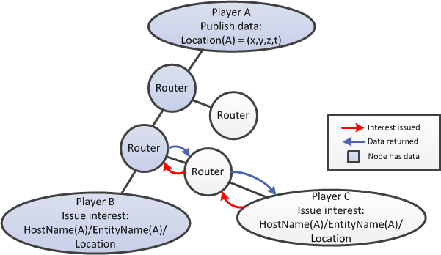
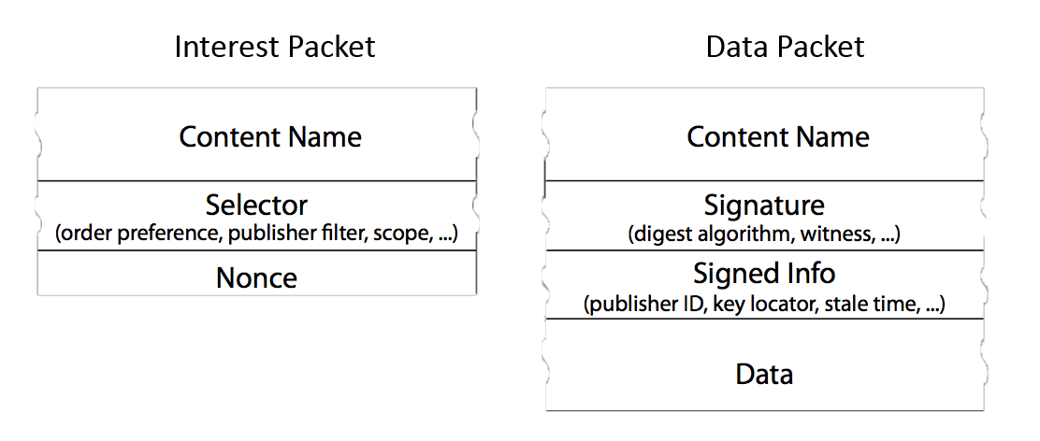
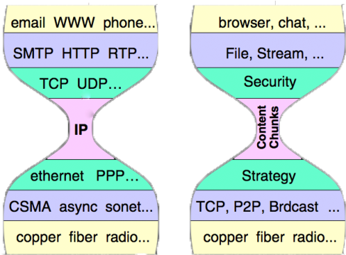
Background – Named Data Network
New internet architecture
Content centric
Strength utilized
Multicast support and data sharing
Interest and data packets
(Jacobson et al., 2009)
Answering an interest from router content store
NDN hourglass model (Jacobson et al., 2009)
Notes:
Named data network differs from today’s IP network by taking a content centric approach. Architecturally speaking, IP layer in TCP/IP structure is replaced with content chunk, which is shown in the hourglass figure.
In IP network, we always have IP addresses for each packet, while in NDN, we have content name instead, which is shown in the figure describing the structure of interest and data packets.
It can be summarized as: in IP, we focus on where the data is, while in NDN, we focus on what the data is.
Designing apps in NDN focuses on what question do I ask the network instead of where do I get something, where that data is stored no longer matters to me.

Slide 4
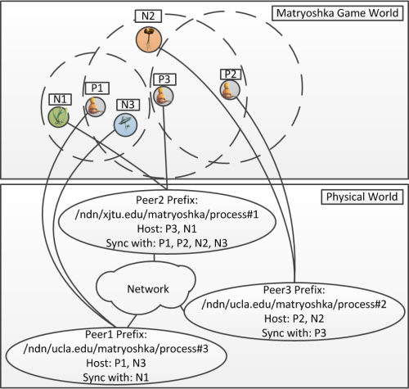
Problem Analysis
Problem:
Distributed environment
Virtual environment
Synchronization
Requirements
Locality: Area of interest
Realtime-ness
Scalability
Robustness
The problem of synchronization
Notes:
Synchronization: When a player does something, how to make those who are interested in his updates know? (Wow it sounds pub/sub)

Slide 5
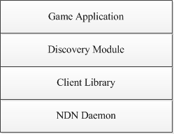
Structural Analysis
Four-level summary
NDN daemon: NDN process
Client library: Development toolkit
Discovery module
Game application

Slide 6
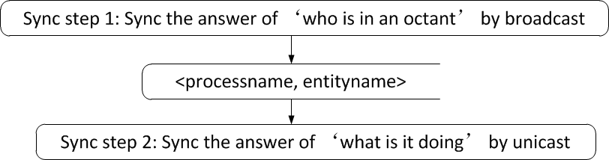
Design Overview
To make sync data sharable
Octree partitioning
To maximize scalability
Two-step sync
Two step sync

Slide 7
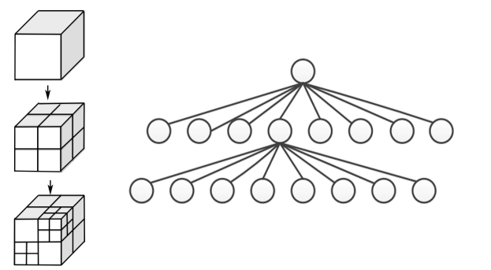
Design Details – Octree
Octree partitioning: shared namespace, unique mapping from 3D vector to hierarchical octree indices
Octree partitioning of gameworld (Kumar et al., 2012)

Slide 8
Design Details – Discovery Module
Discover who’s in an octant: synchronize the dataset of names in a given octant
Periodical broadcast of octant indices + digest of name dataset
Digest calculated from the dataset of names
Separate state/digest synchronization from data synchronization

Slide 9
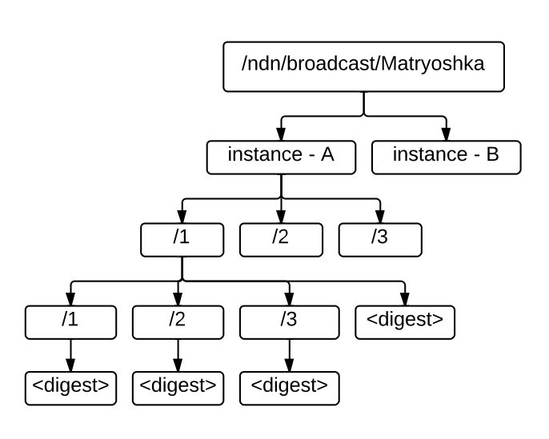
Design Details – Discovery Namespace
Summarizing the design, the discovery namespace looks like:
Matryoshka discovery namespace

Slide 10
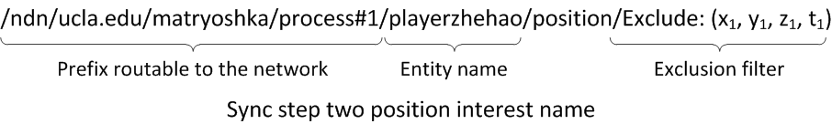
Design Details – Update Module
Sync step two asks ‘what is it doing’
Response handling
Position received?
Within AoI?
Octant indices changed since last update?

Slide 11
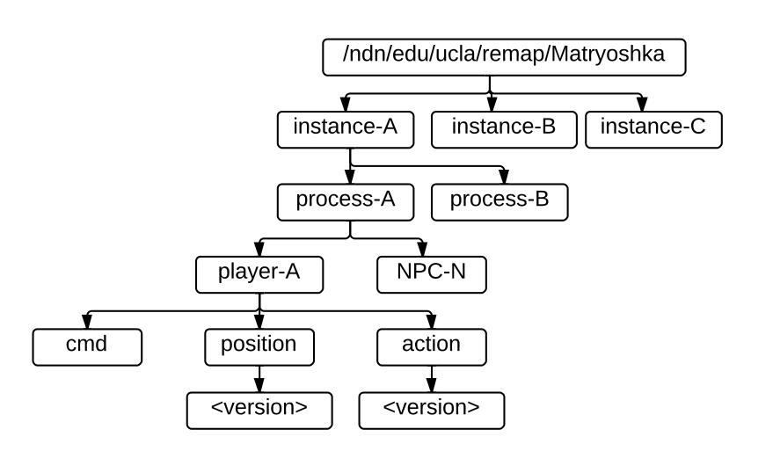
Design Details – Update Namespace
Summarizing the design, the position and action update namespace is given below.
Matryoshka update namespace

Slide 12
Implementation
NDN common client library in C#
Synchronization module
Player discovery
Thrice per second player position update
Game application

Slide 13
Implementation – Short demo

Slide 14
Optimizations
Interest aggregation
Progressive discovery
Event-driven interest expression

Slide 15
Evaluations
Theoretical analysis
Locality
Realtime-ness
Scalability
Robustness
Comparison with previous approaches
LSH based virtual environment partitioning
Invertible bloom filter based knowledge expression
Partial P2P design
IP P2P design
IP C/S design

Slide 16
Conclusions & Future Work
Summary of my work
Design and implementation of DVE synchronization in NDN environment
Implementation of NDN Common Client Library in C#
Conclusion
Provided a working design and implementation
Future work
Evaluation in actual environment
Game application optimization: Interpolation and prediction

Slide 17
Reference & Acknowledgement
Reference
V. Jacobson, D. K. Smetters, J. D. Thornton, M. Plass, N. Briggs, and R. Braynard. Networking named content. Commun. ACM, 55(1):117-124, January 2012
D. Eppstein, M. T. Goodrich, F. Uyeda, and G. Varghese. What’s the difference?: efficient set reconciliation without prior context. SIGCOMM Comput. Commun. Rev., 41(4):218-229, August 2011.
Z. Zhu, C. Bian, A. Afanasyev, V. Jacobson, and L. Zhang. Chronos: Serverless multi-user chat over ndn. Technical Report NDN-0008, NDN, October 2012.
S. Kumar, L. Shi, N. Ahmed, S. Gil, D. Katabi, and D. Rus. Carspeak: a content-centric network for autonomous driving. SIGCOMM Comput. Commun. Rev., 42(4):259-270, August 2012.
Acknowledgement
Co-worker: Zening Qu, Artwork: Ren Rong
Mentor: Prof. Lixia Zhang, Prof. Jeff Burke

Slide 18
Q & A
Zhehao Wang
wangzhehao410305@gmail.com

